Slide 1

Tactile Navigation Support for Blind Individuals
by
M. Joshika
Roll No. 204G1A0545
H. Arshia Parveen
Roll No. 204G1A0515
K. Hemanth Reddy
Roll No. 214G5A0506
G. Akshaya
Roll No. 214G5A0501
Under the guidance of
Dr. B. HariChandana M.Tech.Ph.D
Associate Professor
Department of Computer Science and Engineering
Srinivasa Ramanujan Institute of Technology
(Autonomous)
2023 - 2024

Slide 2

Contents
Review-0 Comments
Review-1 Comments
Abstract
Problem statement
Objectives of Project
Proposed Work -(Methods to be followed for proposed system)
Literature survey for first objective
Objective- 1(Design & Implementation)
Literature survey for second objective
Objective- 2(Design & Implementation)
References
GitHub Link
Queries

Slide 3
Abstract
Sighted individuals possess the ability to navigate their surroundings with ease and utilize their visual facility to promptly identify potential hazards. Conversely, individuals who are visually impaired are unable to perceive the external environment, traverse independently, or discern danger. Moreover, they may occasionally feel distressed and wish to notify their family or friends of their location via text. So, the primary challenge faced by visually impaired individuals is their reliance on others, as even their closest relatives may not always be able to provide adequate care. To address this issue, a "Smart Stick" would be developed utilizing the "Internet of Things". Using a variety of sensors, including ultrasonic, soil moisture, RF, GPS-GSM modules and using Arduino UNO, the Smart Stick empowers blind people to be independent and gives them a sense of normalcy.
Keywords: Arduino UNO, Smart Stick, User Notification Setup.

Slide 4
Review-0 Comments
Which type of material is used to design a stick?
Does the stick work, when fallen in a wet surface?
What is the minimum height of the stick?
Focus more on Literature Survey

Slide 5
Review-0 Comments
Carbon fiber is a suitable material for making a blind stick. Carbon fiber stick have become increasingly popular for individuals with visual impairments due to their several advantages like Lightweight, Strength, Flexibility, Sensitivity, and Durability.
A white cane made from materials that are more water-resistant, such as carbon fiber, which is less prone to damage from moisture. These materials can withstand exposure to water better than some other materials. Cane covers can help provide better grip and protection for the stick on wet surfaces.
The minimum height of blind stick is 2.5 – 3.5 feet

Slide 6
Review-1 Comments
How Ultrasonic sensor works when the object is in front of the Smart stick?
Why Solar panels are used?

Slide 7
Review-1 Comments
The ultrasonic sensor is used to detect obstacles in the path of the user. It emits high-frequency sound waves and measures the time taken for the waves to bounce back from objects in the vicinity. Based on this information, the device alerts the user about the presence of obstacles.
The solar panels are used to provide power to the device. They can be used to recharge the battery during the day, ensuring that the device remains operational even in areas without access to a power source.

Slide 8
Problem Statement
Blind persons always struggle with their daily tasks since they are unable to see even a single thing.
When using a standard blind stick, blind persons have trouble recognizing stairs and obstacles surrounded by them.
By making the use of smart blind stick, we can hear alert noises to identify stairs and obstacles.

Slide 9
Objectives of Project
Research Objective-1:To develop a model that will enable blind persons to navigate both familiar and unfamiliar places without the use of guides. To alarm the user through vibration to determine the obstacles direction sources.
Research Objective-2:To create a user-friendly interface that makes use of tactile feedback and sensations that are simple for blind users to grasp and interpret, enabling them to make independent.

Slide 10
Proposed System
The proposed system is capable of detecting the surroundings for various barriers of different sizes and producing the required auditory using the ultrasonic sensor in the presence of buzzer. When damp surfaces are detected using sensors, it might alert the user by vibratory sounds and also enable to send SMS based on the user's location in an emergency or when they are having trouble. When the stick is misplaced, the user can find the stick by using an RF remote control.

Slide 11
Literature survey for first objective
This paper outlines the creation of a walking stick for a person who is vision impaired utilizing an ultrasonic sensor. The blind person is alerted by a buzzer, and obstructions in their path are detected by the ultrasonic sensor module. The main component in this system is the PIC microcontroller. The blind can travel safely with the aid of this walking stick. It is capable of detecting obstructions between 5 and 35 cm away. However, this technology was unable to identify stairs and damp surfaces.[1]

Slide 12
Design and implementation of first objective
Steps to download the Arduino IDE
1. Head to https://www.arduino.cc/en/main/software
2. Scroll to 'Download the Arduino IDE' and select the Windows or MAC
download.
3. Click 'Just Download'.
4. Open the .zip file to start installation.
5. Follow the steps to install the software on each computer that will be used.

Slide 13
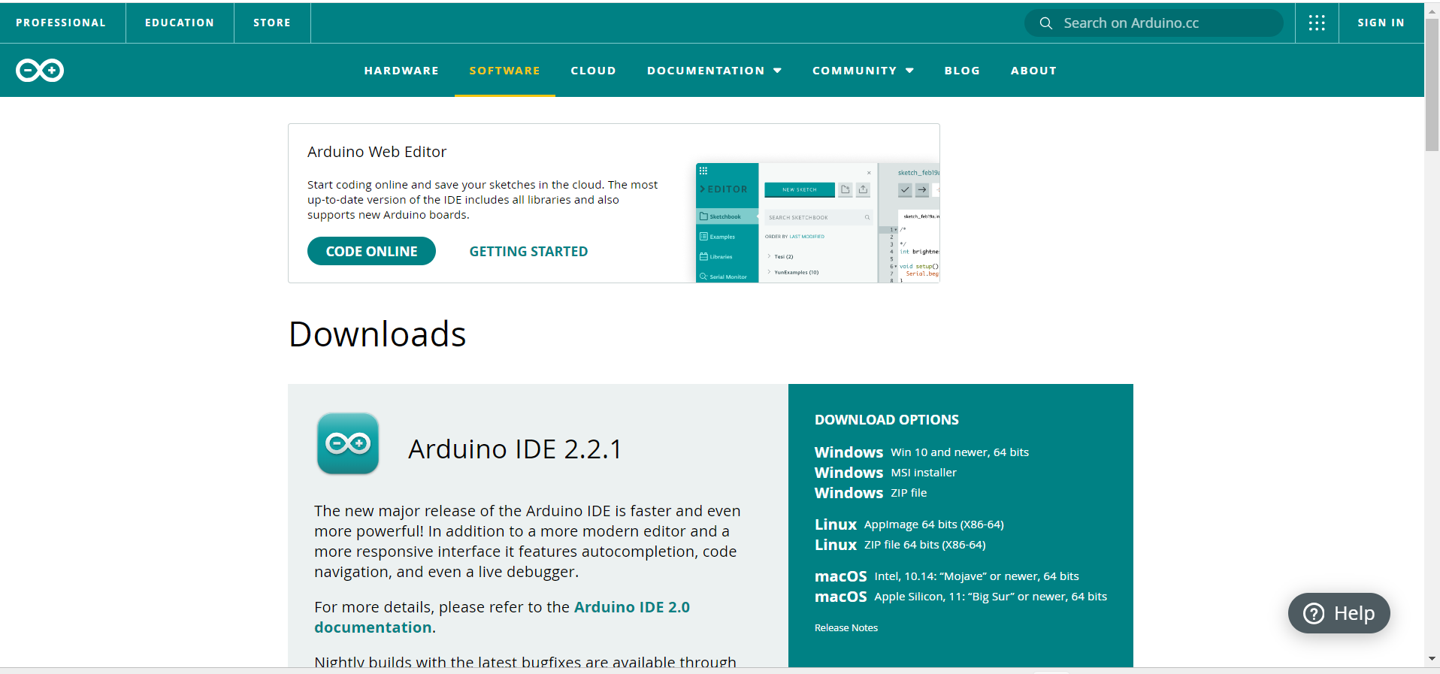
Design and implementation of first objective
Fig 1.1 Download setup for Arduino UNO

Slide 14
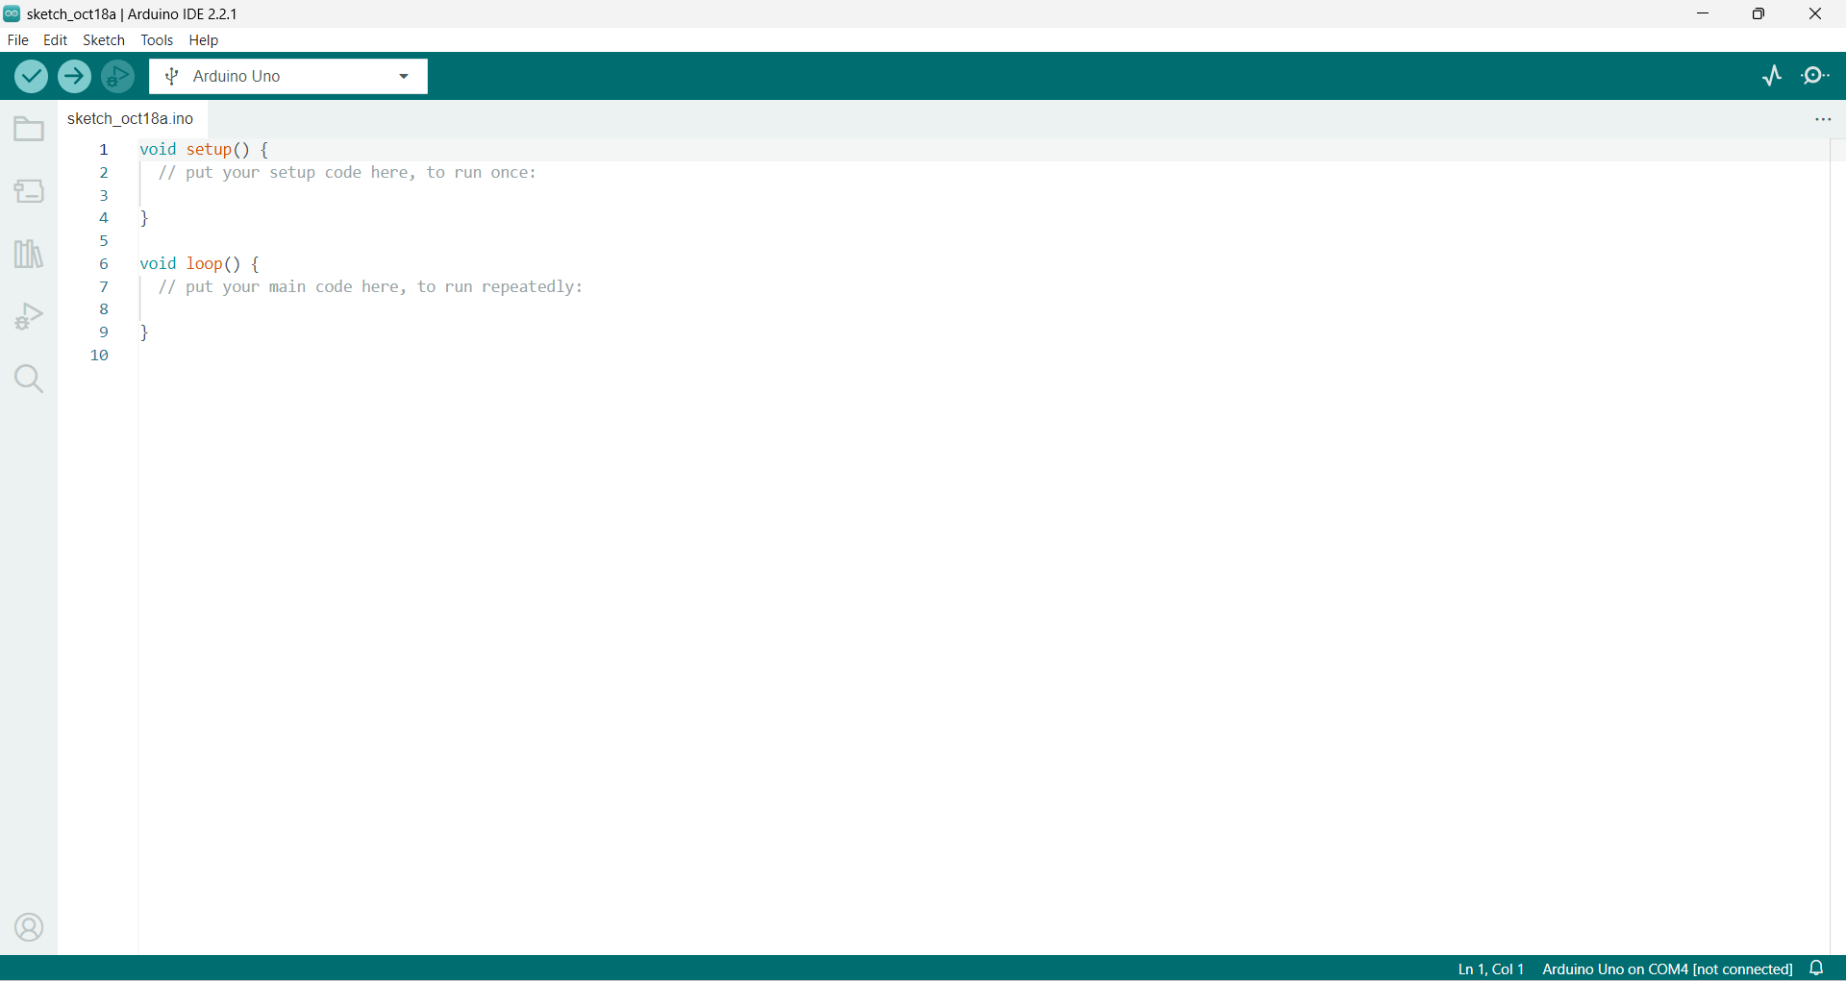
Design and implementation of first objective
Fig 1.2 Page View of Arduino UNO IDE

Slide 15
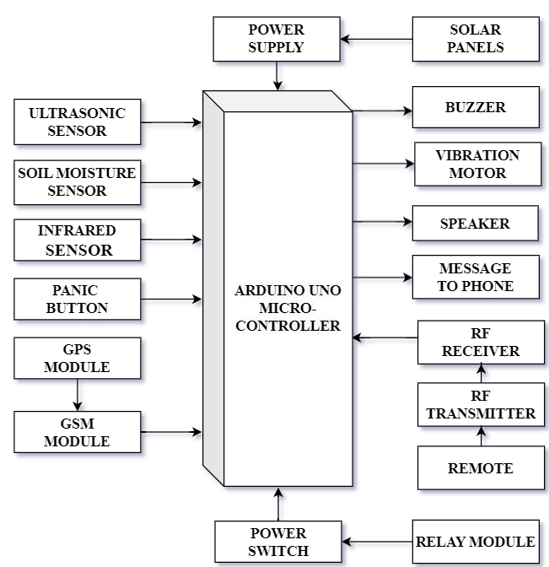
Design and implementation of first objective
Fig 1.3 Block Diagram for proposed system

Slide 16
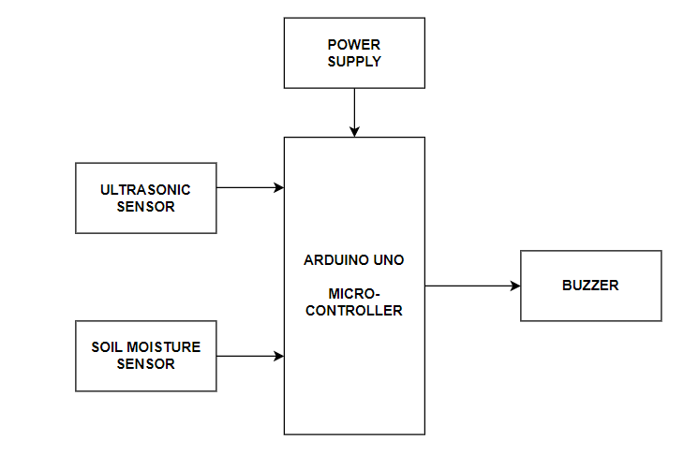
Design and implementation of first objective
Fig 1.4 Block Diagram to detect obstacles and water surfaces

Slide 17
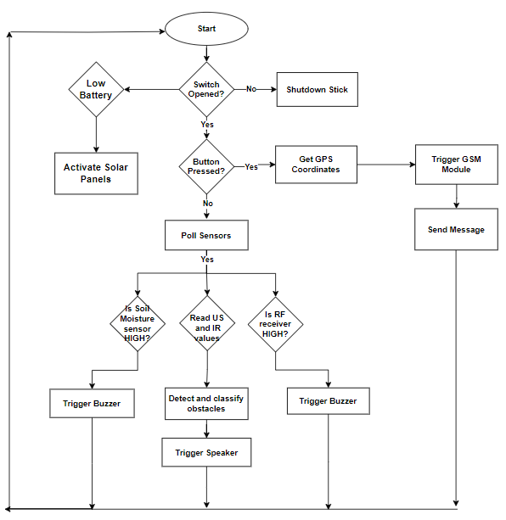
Design and implementation of first objective
Fig 1.5 Flow Chart for proposed system

Slide 18
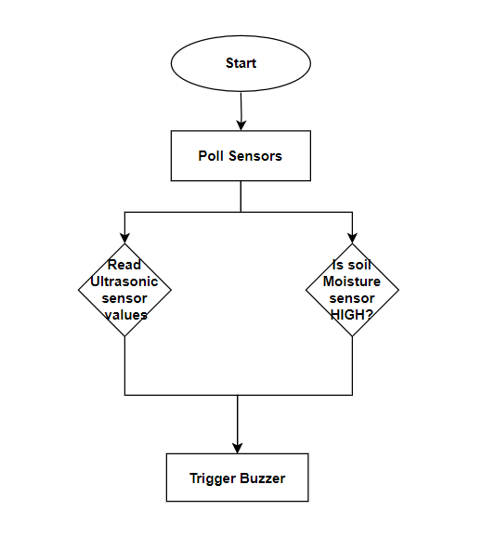
Design and implementation of first objective
Fig 1.6 Flow chart for detecting obstacles and water surfaces

Slide 19
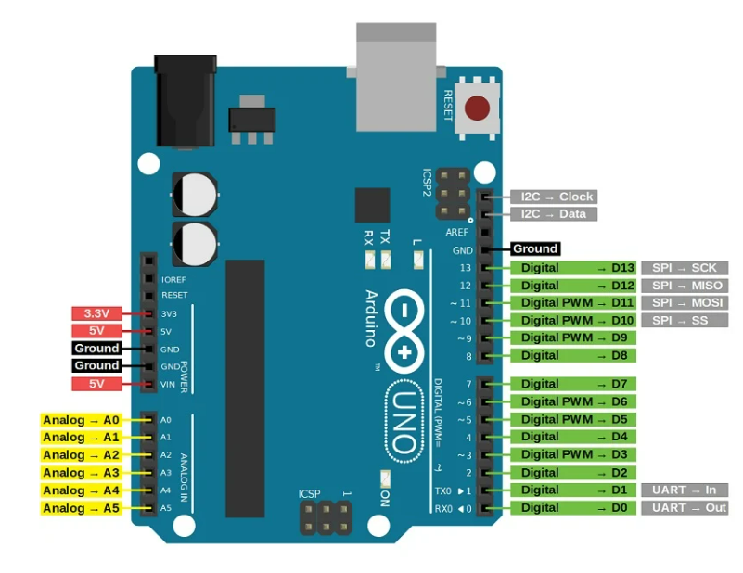
Design and implementation of first objective
Fig 1.7 Arduino UNO Pinout

Slide 20
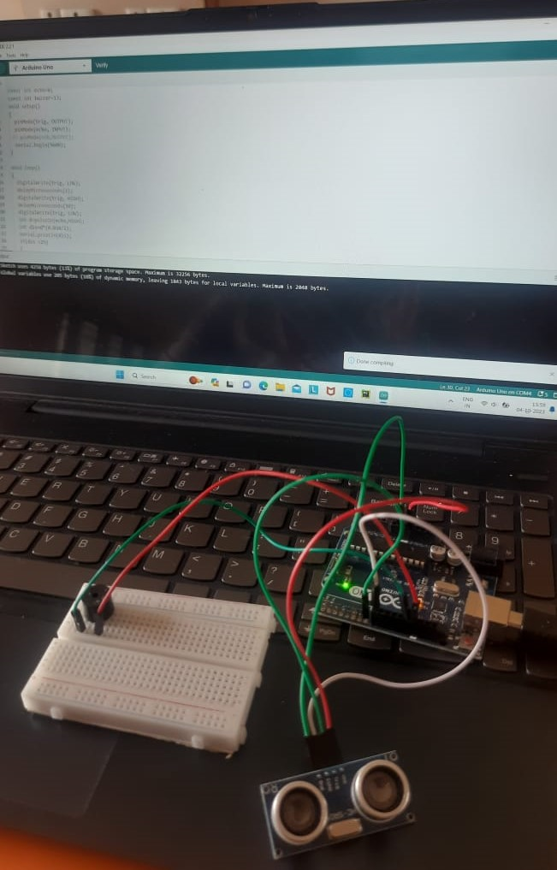
Design and implementation of first objective
Fig 1.8 Obstacle Detection by Ultrasonic Sensor

Slide 21
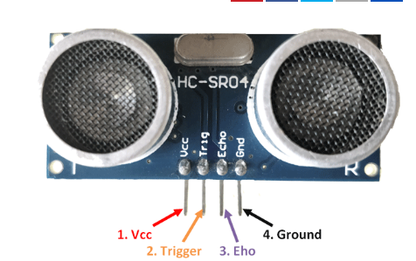
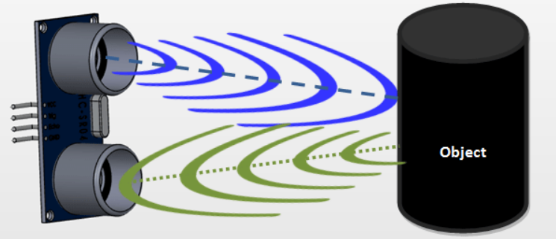
Design and implementation of first objective
Fig 1.9 HC-SR04 Ultrasonic Sensor Pinout
Fig 1.10 Sensing the objects using Ultrasonic Sensor

Slide 22
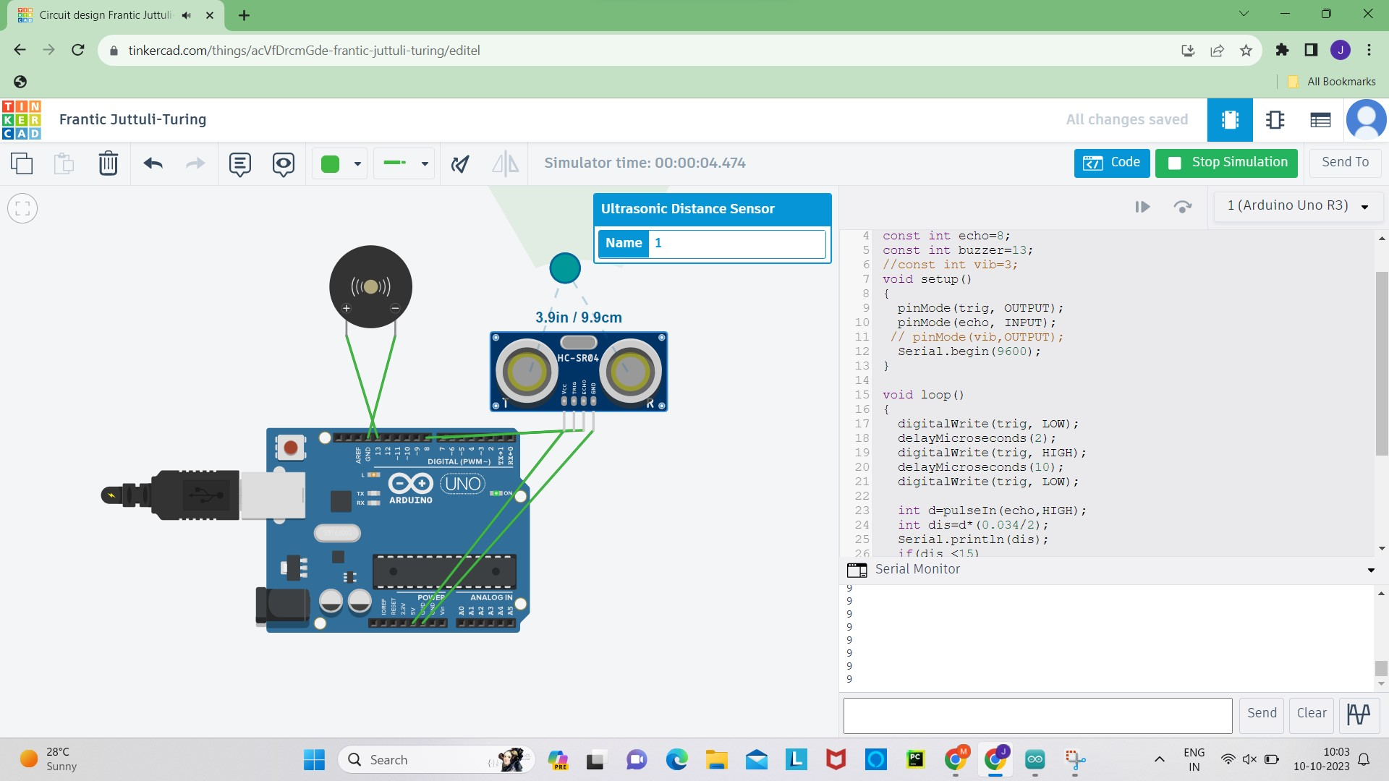
Design and implementation of first objective
Fig 1.11 Object Detected and Triggered Buzzer

Slide 23

Design and implementation of first objective
Fig 1.12 No Object Detected and Buzzer not triggered

Slide 24
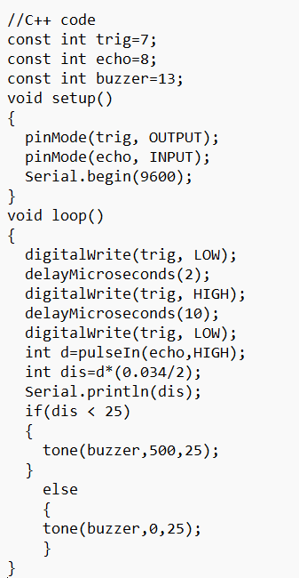
Design and implementation of first objective
Implementation of code for ultrasonic sensor

Slide 25
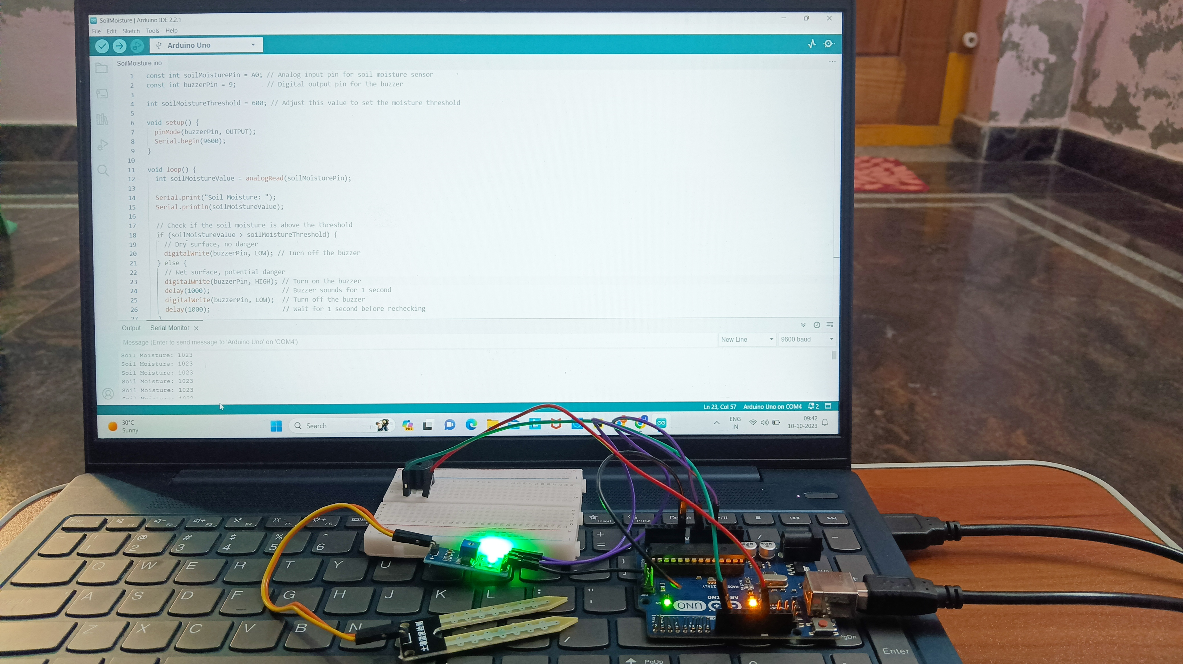
Design and implementation of first objective
Fig 1.13 Water Detection by Soil Moisture Sensor

Slide 26
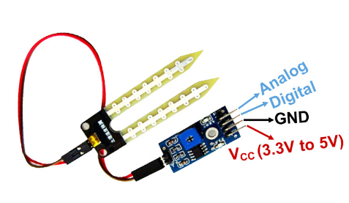
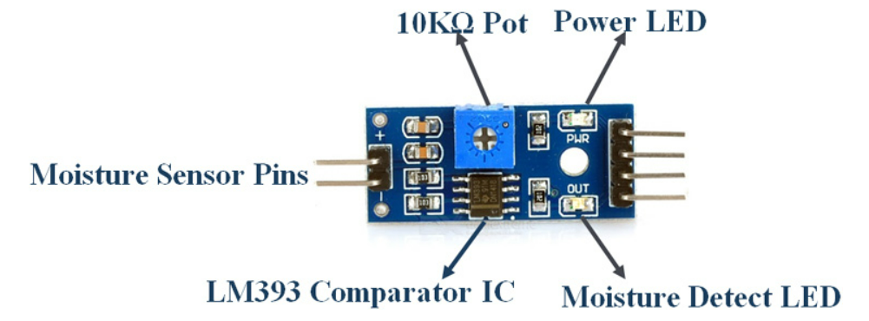
Design and implementation of first objective
Fig 1.15 Soil Moisture Sensor Pinout
Fig 1.14 Soil Moisture Sensor

Slide 27
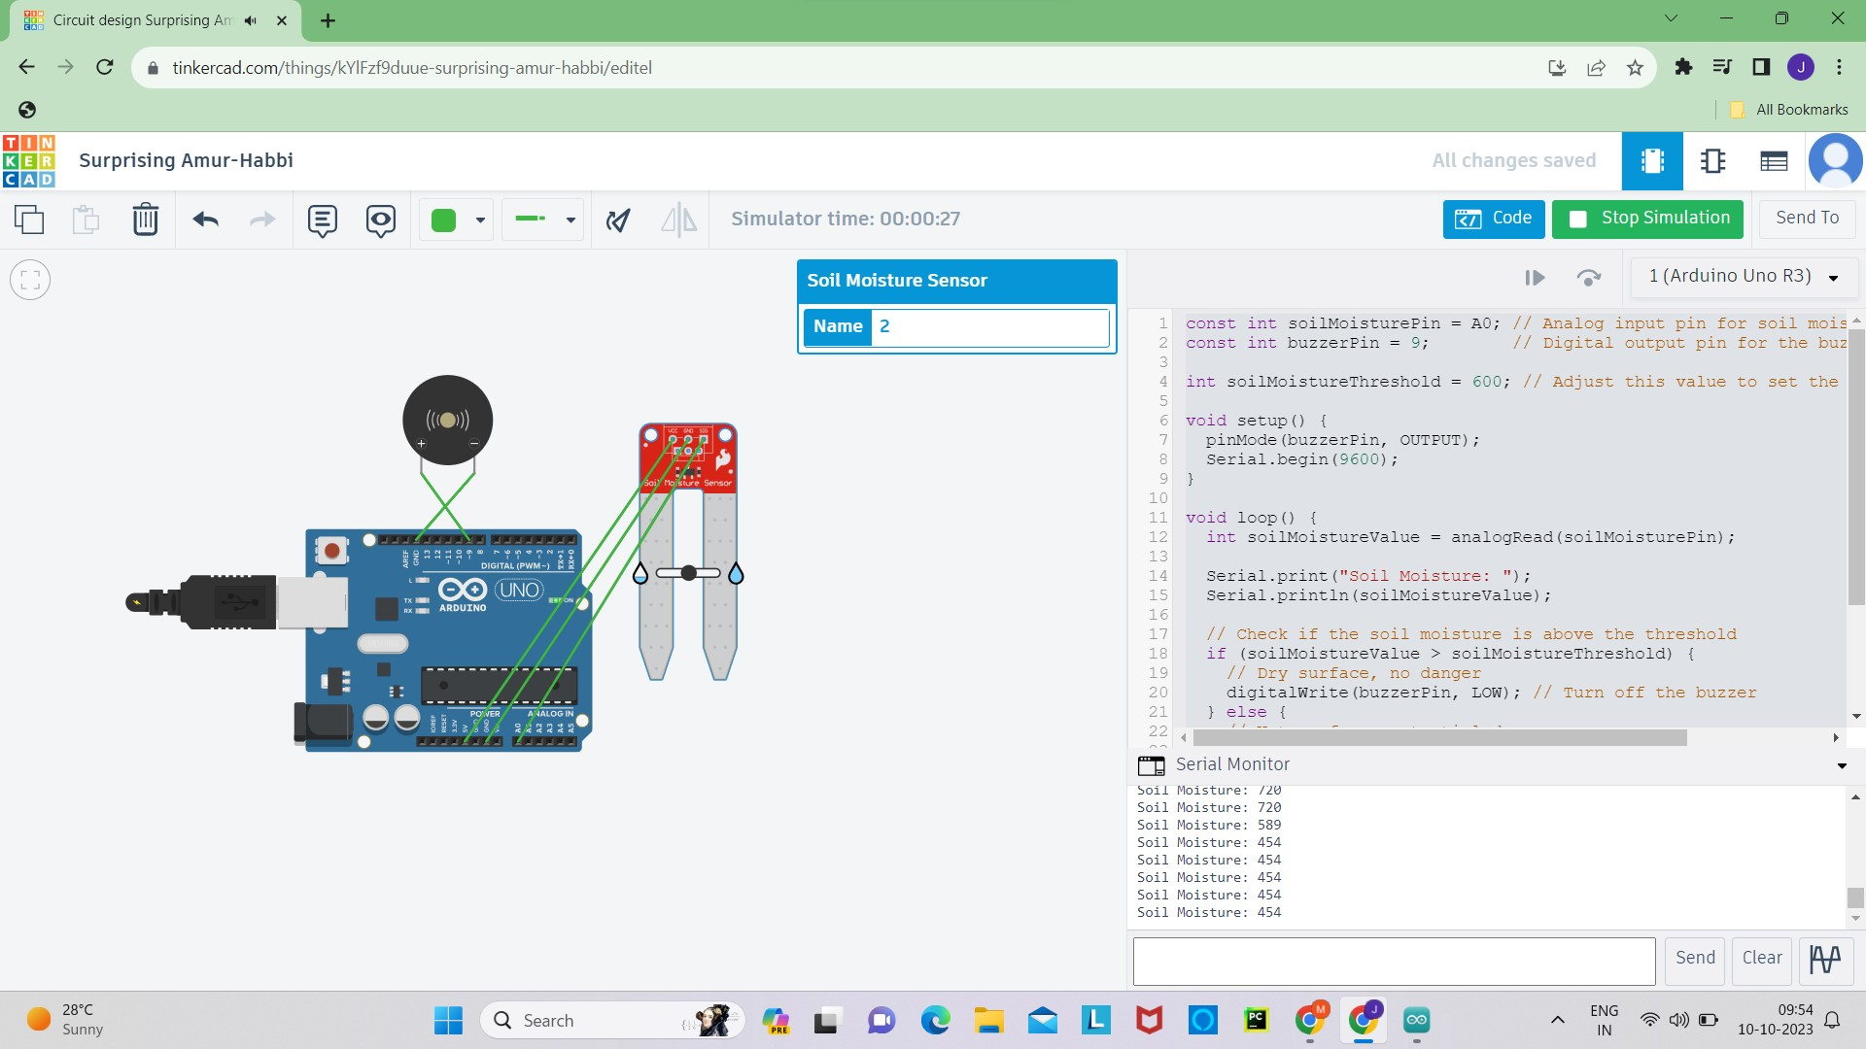
Design and implementation of first objective
Fig 1.16 Water Detected and Triggered Buzzer

Slide 28

Design and implementation of first objective
Fig 1.17 No Water Detected and Buzzer not triggered

Slide 29
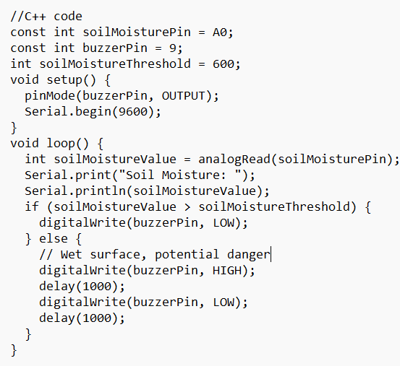
Design and implementation of first objective
Implementation of code for soil Moisture sensor

Slide 30
Literature survey for second objective
The authors of this study also presented a novel walking assistance for the blind that enables blind people to travel. Along with object and water sensors, the blind stick also has an ultrasonic sensor and voice module. The sensor sends information to the Arduino UNO while detecting impediments. The Arduino UNO decides whether the obstruction is close enough after processing the data. If the barrier is not closing the circuit, nothing will happen. If the obstruction is nearby, the Arduino UNO will send out a voice alarm. However, this system only provides a single voice notification when it detects movement of the barrier at a distance of 50 cm.[2]

Slide 31
Contd…
This paper outlines about GPS, which is a satellite navigation system used to determine the ground position of an object. It will update the location of stick to main board. But this system, cannot work indoors because no signal can be received from the GPS navigation system. It has less accuracy of the signals within a range of 5m.[3]

Slide 32
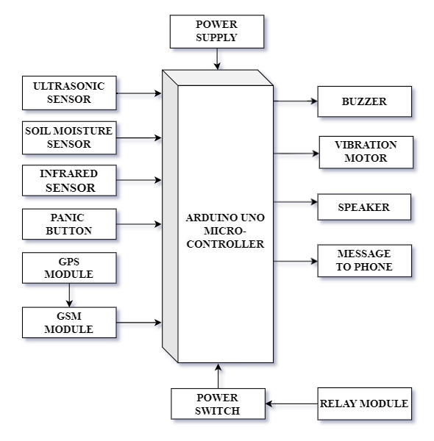
Design and implementation of second objective
Fig 1.18 Block Diagram to detect obstacles, water surfaces and SMS Notifiction

Slide 33
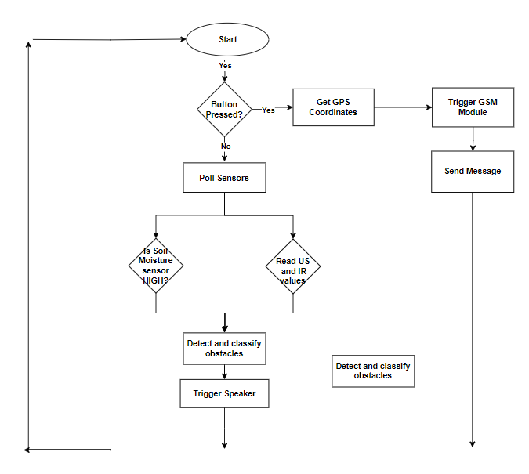
Design and implementation of second objective
Fig 1.19 Flow chart for detecting obstacles, water surfaces and SMS Notification

Slide 34
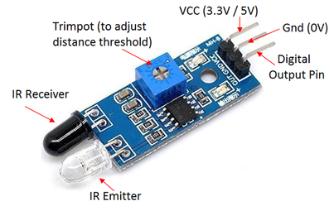
Design and implementation of second objective
An infrared sensor is an electronic device that detects infrared radiation, including movement and object heat. Widely used for object presence detection, it is effective in identifying objects within a specified area.
Fig 1.20 Infrared Sensor

Slide 35
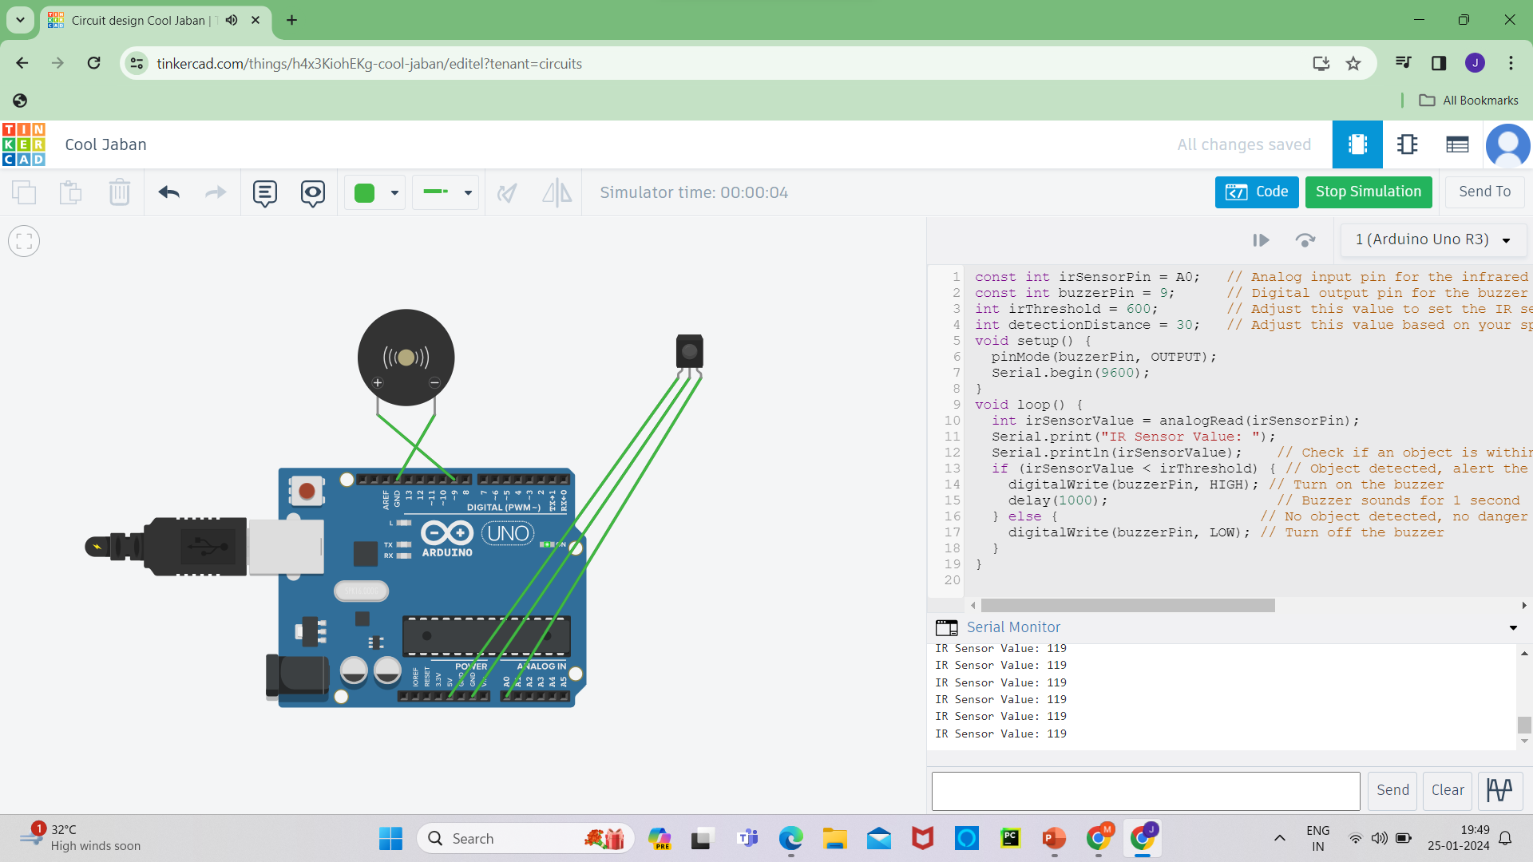
Design and implementation of second objective
Fig 1.21 Object Detected and Triggered Buzzer

Slide 36
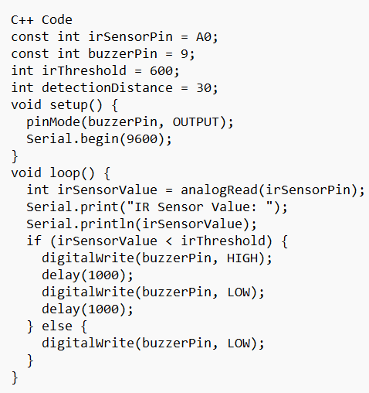
Design and implementation of second objective
Implementation of code for Infrared sensor

Slide 37
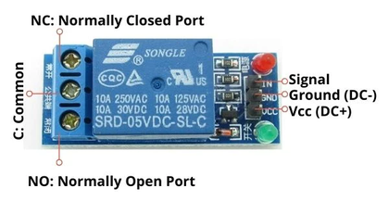
Design and implementation of second objective
A relay module is an electrical switch that is operated by an electromagnet. When activated, the electromagnet pulls to either open or close an electrical circuit.
Fig 1.22 Relay Module

Slide 38
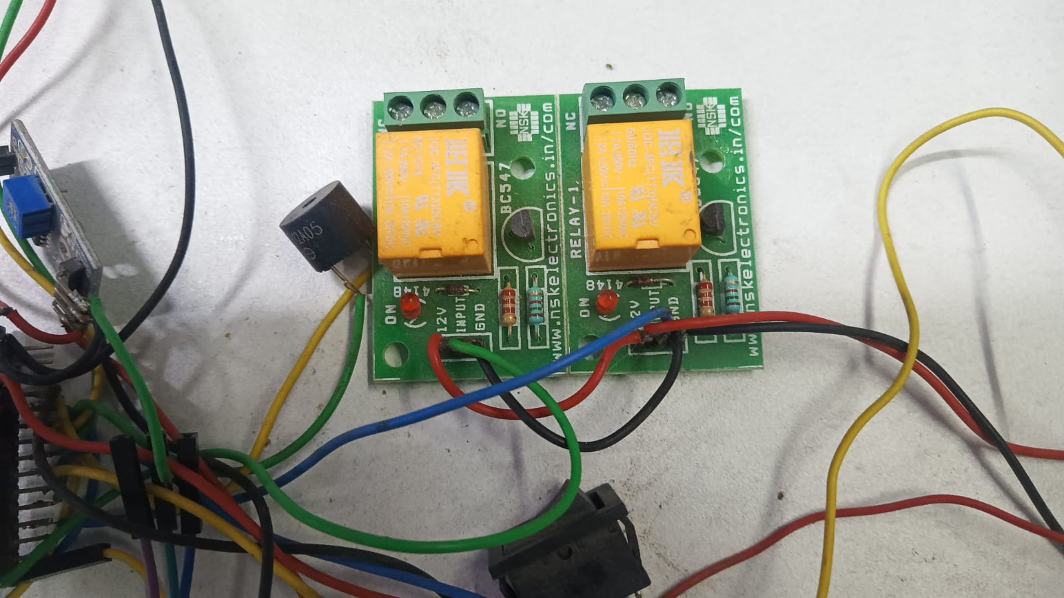
Design and implementation of second objective
Fig 1.23 Power on & off for the RF Module & Push Button

Slide 39
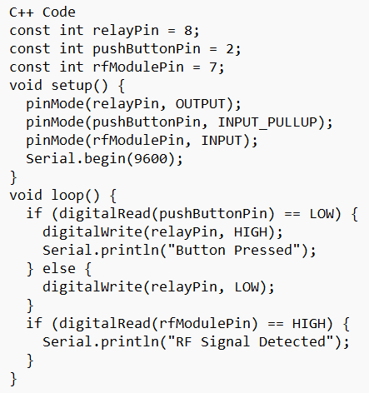
Design and implementation of second objective
Implementation of code for Relay Module

Slide 40
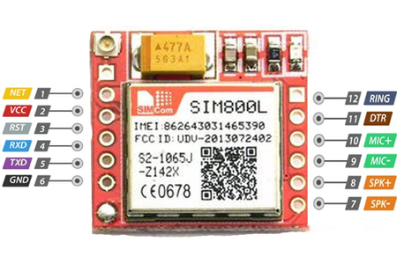
Design and implementation of second objective
The GSM(Global System for Mobile Communication) module is responsible for establishing and maintaining the communication link between the device and the GSM network. To notify family members via SMS in the event of an emergency. Both a cellular network and a SIM card are necessary for it to work.
Fig 1.24 GSM Module

Slide 41
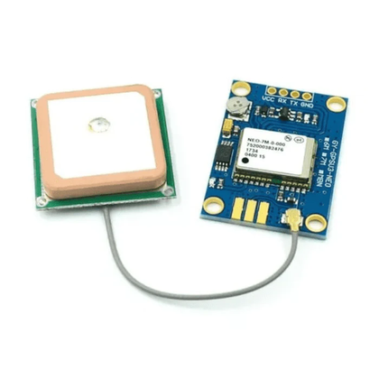
Design and implementation of second objective
GPS (Global Positioning System) is a satellite-based navigation system. It provides time and location-based information to a GPS receiver, located anywhere on or near the earth's surface. It is used to give the blind person's location information to those who are concerned about them. It can send latitude, longitude, altitude, and time information to the Arduino Uno using serial communication.
Fig 1.25 GPS Module

Slide 42
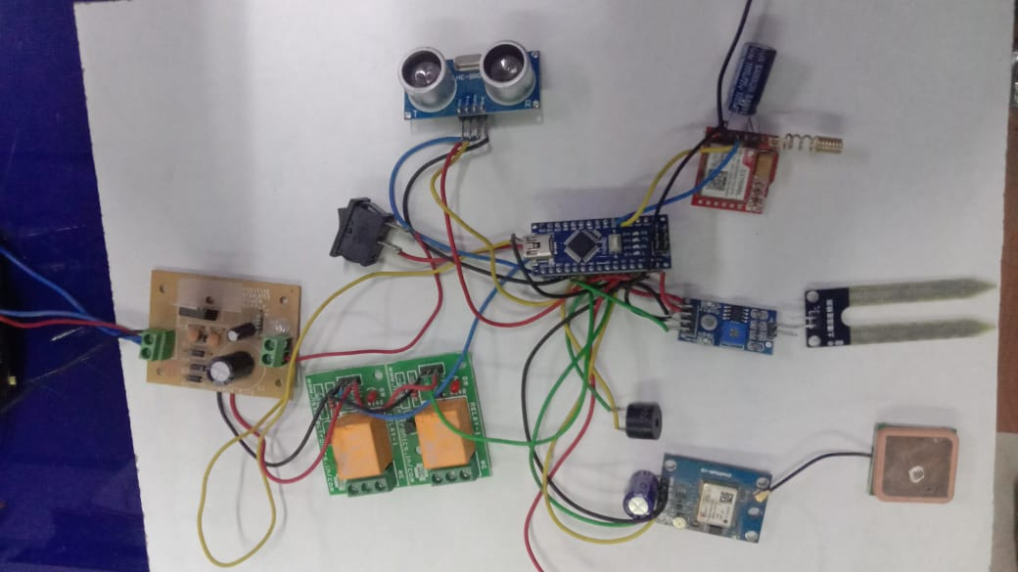
Design and implementation of second objective
Fig 1.26 Circuit Diagram

Slide 43
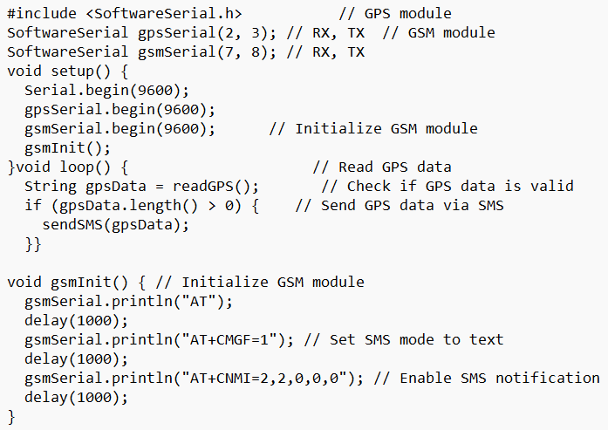
Design and implementation of second objective
Implementation of code for GPS-GSM Module

Slide 44
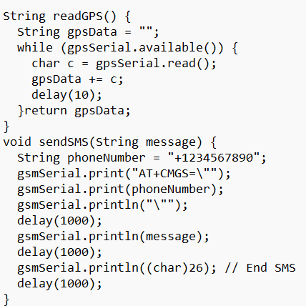
Design and implementation of second objective
Implementation of code for GPS-GSM Module

Slide 45
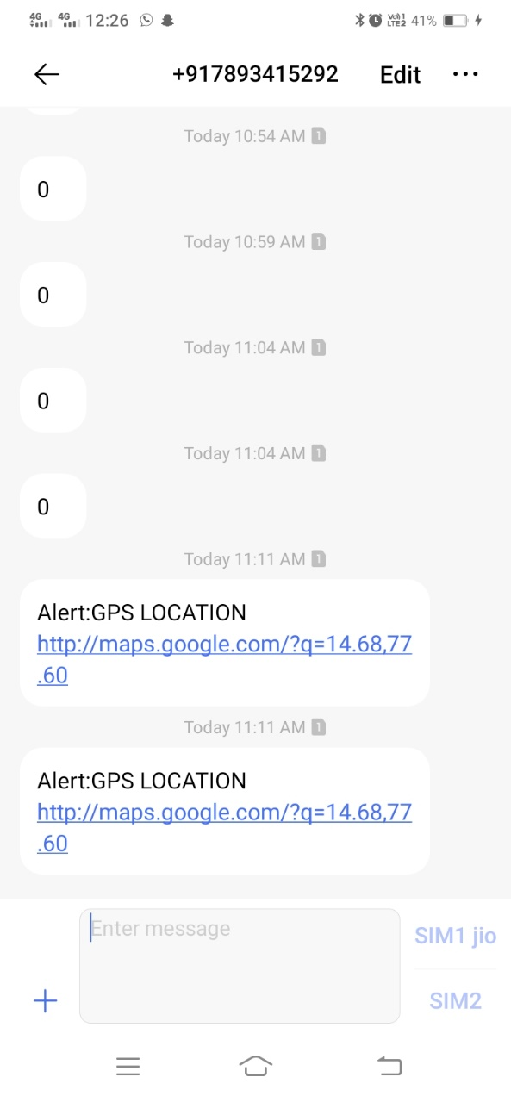
Design and implementation of second objective
Fig 1.27 SMS Notification with GPS Location

Slide 46
References
[1]. Naiwrita Dey, Ankita Paul, Pritha Ghosh, Chandrama Mukherjee, Rahul De,
“Ultrasonic Sensor Based Smart Blind Stick”, International
Conference on Current Trends toward Converging Technologies,
Coimbatore, India, 978-1-5386-3702-9/18 2018.
[2]. Md.Adil, TaiyabaShadaka Rafa, Jannatul Ferdoush, Abir Mahmud, Abhijit
Pathak, “An IoT based Voice Controlled Blind Stick to Guide Blind People”,
International Journal of Engineering Inventions, Volume 9, Issue 1
[Jan 2020].

Slide 47
References
[3]. Somnath koley, Ravi Mishra, ”Voice operated outdoor navigation system for
visually impaired persons”, International Journal of Engineering Trends and
Technology- Volume3Issue2- 2012.
[4]. Suraj Babhale, Pratiksha Bhagat, Nikhita Saharkar, Mayur Pillewan, Nikhil
Rangari, V. N. Mahawadiwar, “Implementation of Smart Stick for Blind and
Visually Impaired People using Arduino”, International Journal of
Innovative Research in Science, Engineering and Technology, Volume 10,
Issue 6, June 2021

Slide 48
References
[5]. M. Ghana Shyam, Shravankumar G M, Ashabee, Kodal Ashwini, Ravi
Kumar H M, ”Blind guide stick using GPS and GSM module”, International
Research Journal of Engineering and Technology Volume 7, Issue 6, June
2020.
[6]. Ronak Panchal, Sneha Sankhe, Saad Khan, Vishal Singh, “Blind Stick for
Visually Impaired People”, International Research Journal of Engineering
and Technology Volume 8, Issue 5, May 2021.

Slide 49
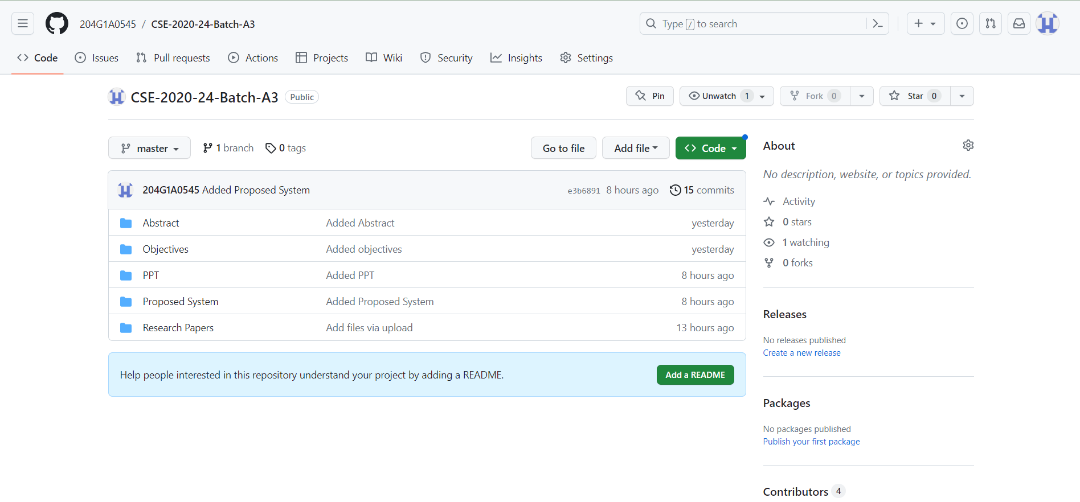
Git Hub Dashboards of each student
Git Hub Link : https://github.com/204G1A0545/CSE-2020-24-Batch-A3.git

Slide 50
Any Queries?

